Slide 1
Big Data Processing
Jiaul Paik
Lecture 10

Slide 2
What I am Going to Tell You Today

Slide 3
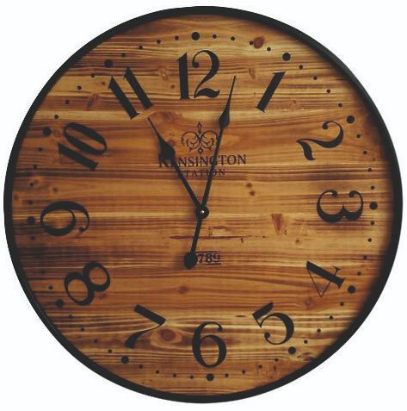
Quick Recap of Map-reduce programming model
Map-reduce Algorithm Design
The problem for which google invented map-reduce
Map-reduce algorithm for database table join
Bad map-reduce program: An interesting case study

Slide 4
Recap: Map-reduce Programming Model

Slide 5
Map-reduce System: Inside Look
map task 1
map task 2
map task 3
data | data | data
data | data | data
data | data | data
M
M
M
M
M
M
M
M
M
map phase
($k_{1}, v_{1}$) ($k_{2}, v_{2}$) | ($k_{3}, v_{4}$) | ($k_{4}, v_{4}$)
($k_{2}, v_{1}$) | ($k_{1}, v_{4}$) ($k_{2}, v_{2}$) | ($k_{3}, v_{5}$)
($k_{2}, v_{6}$) | ($k_{3}, v_{7}$) | ($k_{1}, v_{5}$)
partition function
partition function
partition function
shuffling through network
SORT and GROUP
$$k_{1}:{ v}_{1},v_{4},v_{5}$$ | $$k_{4}:v_{4}$$
SORT and GROUP
$$k_{2}:v_{2},v_{1},v_{2},v_{6}$$ | $$k_{3}:v_{4},v_{5},v_{7}$$
R
R
R
R
reduce phase
Final output | Final output
Final output | Final output
reduce task 1
reduce task 2

Slide 6
Mapreduce Types
map function
K1 -> input key
V1 -> input value
K2 -> output key
V2 -> output value
map: (K1, V1) → list(K2, V2)

Slide 7
Mapreduce Types
reduce function
K2 -> input key
list(V2) -> list of values associated with a key K2
K3 -> output key
V3 -> output value
reduce: (K2, list(V2)) → list(K3, V3)

Slide 8
Mapreduce Types
combiner function
It has the same form as the reduce function
K2 -> input key
list(V2) -> list of values associated with a key K2
K3 -> output key
V3 -> output value
combiner: (K2, list(V2)) → list(K3, V3)

Slide 9
Mapreduce Types
partition function
operates on the intermediate key and value types
returns the partition index
the partition is determined solely by the key
K -> input key
V -> value
partition: (K, V) → integer (partition index)

Slide 10
Map-Reduce Algorithm Design

Slide 11
Why Google had to Invent Map-Reduce?

Slide 12
Search Engine Architecture
query
Documents
online
offline
Representation
Function
Representation
Function
Retrieval
Indexing
Query Representation
Document Representation
Index
Ranking
Function
Results
Source: Jimmy Lin

Slide 13
Creating Index
Inverted Index Structure
Doc 1
one fish, two fish
Doc 2
blue
1
2
1
red fish, blue fish
cat
1
3
1
Doc 3
egg
1
4
1
cat in the hat
fish
2
1
2
2
2
Doc 4
green
1
4
1
green eggs and ham
ham
1
4
1
hat
1
3
1
one
1
1
1
red
1
2
1
two
1
1
1

Slide 14
Inverted Index Structure (with positions)
Doc 1
1
one fish, two fish
blue
2
1
[3]
cat
1
3
1
[1]
Doc 2
egg
1
4
1
[2]
red fish, blue fish
fish
2
1
2
[2,4]
2
2
[2,4]
Doc 3
green
1
4
1
[1]
cat in the hat
ham
1
4
1
[3]
Doc 4
hat
1
3
1
[2]
green eggs and ham
one
1
1
1
[1]
red
1
2
1
[1]
two
1
1
1
[3]

Slide 15
MapReduce: Index Construction
Map over all documents
Emit term as key, (docid, tf) as value
Emit other information as necessary (e.g., term position)
Sort/shuffle: group postings by term
Reduce
Gather and sort the postings (by docid)
Write postings to disk

Slide 16
Inverted Index: Basic MapReduce Algorithm
Doc 1
Doc 2
Doc 3
one fish, two fish
red fish, blue fish
cat in the hat
one
1
1
red
2
1
cat
3
1
Map
two
blue
hat
1
1
2
1
3
1
fish
1
2
fish
2
2
Shuffle and Sort: aggregate values by keys
cat
3
1
Reduce
blue
2
1
fish
1
2
2
2
hat
3
1
one
1
1
two
1
1
red
2
1

Slide 17
Inverted Indexing: Pseudo-Code
class Mapper {
map(docid, doc) {
counts = new HashMap()
for (term in tokenize(doc)) {
counts(term) += 1
}
for ((term, tf) in counts) {
emit(term, (docid, tf))
}
}
}
class Reducer {
reduce(term, postings: list[(docid, tf)]) {
p = new List()
for ((docid, tf) in postings) {
p.append((docid, tf))
}
p.sort()
emit(term, p)
}
}

